Slide 1
Unit 3: Text-Based Programming
Lesson 9

Slide 2
and or statements
Until now you have only been doing single tests when evaluating a statement. For example, phrase == "hi" Using and and or, you can build compound evaluations which test multiple statements. For example, phrase == "hi" and name == "Marvin" phrase == "hi" or phrase == "hey"

Slide 3
Example 1 (and)
phrase == "hi" and name == "Marvin" 1. Python will evaluate both statements before and after the and: 1. phrase == "hi" 2.name == "Marvin"
2. Python will apply a logic and to the evaluations:
if statement 1 is True and
statement 2 is True
then the whole statement is True
otherwise it’s False

Slide 4
Example 2 (or)
It is similar for the statement: phrase == "hi" or phrase == "hey"
1. Python will evaluate both statements before and after the or: 1. phrase == "hi" = True / False 2. phrase == "hey" = True / False
2. Python will apply a logic or to the evaluations:
if statement 1 is True or
statement 2 is True or
both are True
then the whole statement is True

Slide 5
Try it!
Use the second example to change your program from Lesson 5 to use an or, so that it responds with “Hello” if you give the phrase “hi” or “hey”.
Change the first if statement in your program if phrase == "hi": to:
Tip: a common error is to write if phrase == "hi" or "hey" as this is how we would say it in English, but in Python, you have to state the condition in full each time.
Run your program. If you give the response “hi” or “hey” then your program should respond with “Hello”.

Slide 6
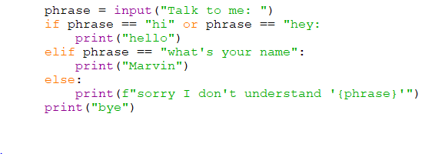

Slide 7
Portfolio 5 - Or
Change your program from the last slide so it tests for “whats your name” or “what’s your name”.
Save the file as your_name_u3_port_5 in your portfolio folder

